Slide 1
PROJECT UPDATES Project Title:- Building CRM using RFM and CLTV
Guided by :- Aditya Sir
Team Members :-
Ashkita Waghmode
Rahila Mulla
Ashish Singh
Ganesh Jadhav
Kishan Mantri
Prateeksha Nachane
Vaibhav Chormule

Slide 2
Problem Statement
A customer is the most important aspect for any business to withstand. Hence Customer Relationship Management(CRM) becomes crucial.
In this model we will be building CRM using RFM(Recency, frequency and Monetary) of the customer and will find the Customer value and their entire relationship with the company.
Here Recency is the freshness of the customer activity, Frequency is the frequency(repetitions) of customer transactions and Monetary is the willingness to spend

Slide 3
FEATURES
Features Names | Description
CustomerID | - Unique ID number for each customer
Stock Code | - Unique code for each item
Description | - Name of the item
Quantity | - The number of items with the invoice
Invoice Date | - Date and time of purchase
Unit Price | - Price of a single item
Invoice No | - The number of the invoice, unique for each purchase. Refund invoice numbers contain "C"
Country | - The country where the customer is living
Customer Name | - Customer Name
Recency | - Recency of Customer Purchase
Frequency | - Repetitions of Customer Purchase
Monetary | - Purchase Value of every Customer

Slide 4
PROJECT INITIALIZATION
Kick-off Meeting :
Challenges faced by Client :
Opportunistic Customer:- Customers were buying products only when they were provided with discount offers. This lead to the company facing an uneven amount of business
Customer Treatment:- The company was giving every customer equal importance
Inventory Management :- To manage popular products and to keep a track of products that are less in demand
Multinational Expansion:- Client was looking to expand into different countries

Slide 5
PROJECT INITIALIZATION
Scope Of Project :
Client’s Scope
Access to Database
Project Representative with domain knowledge(POC)
Company’s Scope
Exploratory Data Analysis (EDA)
Model Building
API building on real time data

Slide 6
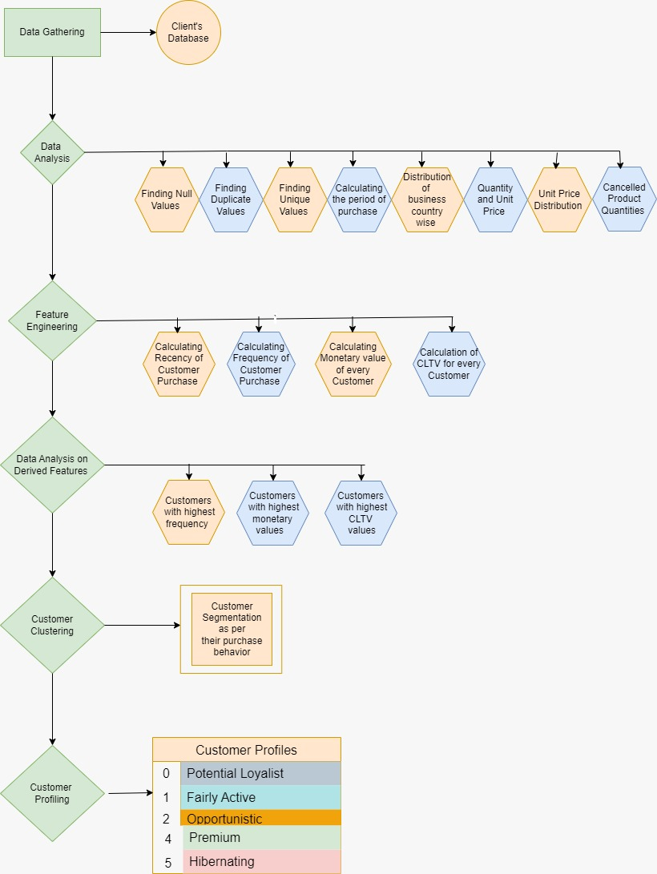
PROJECT FLOW

Slide 7
The table below shows the following:-
1. No. of orders made during the period.
2. No. of Products sold during the period
3. No. of customers that ordered during the period
4. No. of countries product were shipped
Features Names | Unique Values
Invoice No | 25900
Stock Code (No. of Products) | 4070
Customer ID (No. of Customers) | 4372
Countries | 38

Slide 8
Finding the distribution of business across countries:

Slide 10
Other Popular Products

Slide 11
Percentage of Products bought by top 10 Customers

Slide 14
Mostly Cancelled Products Out of all the quantities, around 2% of the products have been cancelled

Slide 15
Customers having highest cancelled Quantity

Slide 16
CLTV Calculation
CLTV = (Customer Value / Churn Rate) * Profit Margin
Where,
Customer Value = Average Order Value * Purchase Frequency
Average Order Value = Total Price / Total Transaction
Purchase Frequency = Total Transaction / Total Number of Customers
Churn Rate = 1 - Repeat Rate
Repeat Rate = Customers that buy products several times / Total Customers
Profit Margin = Total Price * 0.15 (0.15 margin provided by client)

Slide 17
Customer Segmentation
Making Customer Clusters as per their purchase behavior using K means Clustering and scaling the features using Robust Scaler
Finding K values using WCSS method
Visualizing the no. of clusters using Elbow Method
While building the model, we found that there are outliers in CLTV and hence the clustering was improper.
We tried DBSCAN to cluster the features but as the dataset had outliers, there was a formation of negative clusters
Then we had to handle the outliers using Imputation method- IQR method
After this the model building process was repeated and we got the desired clusters
Customers were segmented into 5 groups as per the derived features

Slide 18
Customer Profiling
After the Clusters were formed, we named the customers as per their buying behavior
Premium Customer :- Customers having the highest frequency and highest monetary values
Fairly Active Customer:- Those customers who had a good purchase frequency and monetary value
Potential Loyalist Customer:- Those customers who had a low recency but good monetary value
Opportunistic Customer:- Customers low recency and medium monetary values
Hibernating Customer :- These were the customers that had lowest recency and lowest monetary value as well

Slide 19
Customer Profiling

Slide 20
Data Analysis Benefits
Better Inventory Management
Customer Analysis for different countries
Product generating the most amount of profit
Customers generating the most amount of profit
Products that hold a future value of being popular
Better Customer Treatment as per their CLTV
To provide discounts as per the customer purchase behavior
Customer segmentation

Slide 21
Client Feedback
Client in the Expand and Advocate stages of their business journey are now able to provide the most valuable customer feedback because they are the ones who are most familiar with your products.
Client now can analyze different customer behavior efficiently and now able to set different sells and marketing strategies for different customers according to their profiling.
Client also able to manage inventory by looking at the analysis given by us.

Slide 22
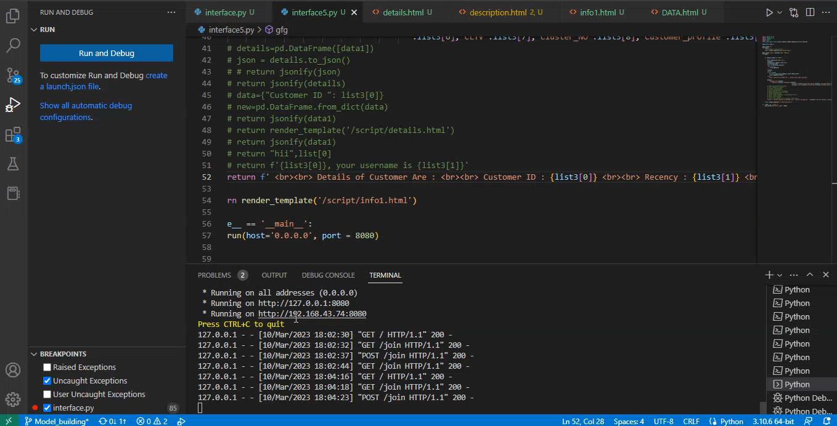
API Building

Slide 23
THANK YOU

